Slide 1
Predicting Toxicity With Deep Learning
By Sean Davern
Notes:
Whether you’ve battled cancer, know someone whose has, or are just health conscious there is a good chance you’re aware of the importance of chemical toxicities. My name is Sean Davern and today I’d like to show you some work I’ve done predicting toxicity using dense neural networks.

Slide 2
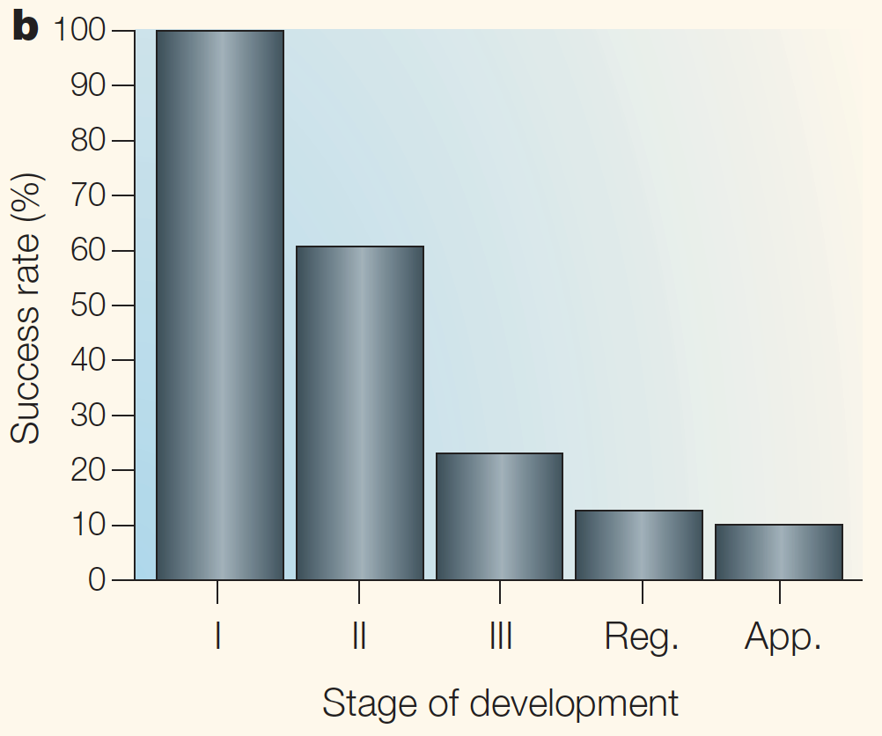
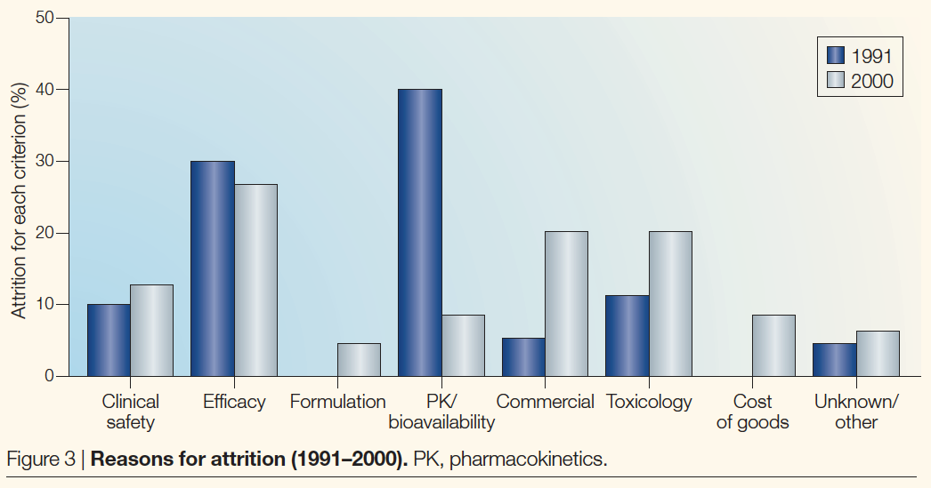
30% of Drugs Fail Clinical Trials due to Toxicity
Lawrence, Stacy. The Biotech Drug Market. Nat Biotechnol 22, 1496 (2004)
Notes:
You’re probably aware of the statistic that 80-90% of drugs fail during commercialization. What you may not know is that 20-30% of the failures are due to their toxicological properties. As a chemical engineer I spent over a decade at the forefront of managing chemical safety. As a Sr. Biotech Process Development Scientist I spent another decade leading the process commercialization of 2 drugs that failed during clinical trials. Now as a Data Scientist I have skills that can be applied to these problems. Let me show you how!
This statistic was cited by NIH: https://tripod.nih.gov/tox21/challenge/about.jsp
2016 statistic was 17% (59 of 344 failures 1998-2015): https://www.ncbi.nlm.nih.gov/pubmed/27723879 - org article source: https://www.ncbi.nlm.nih.gov/pmc/articles/PMC6092479/

Slide 3

Data
Obtain Data
Scrub
Explore
Model
Use
12,700 Compounds
800 Physiochemical and 844 Structural Features
12 Toxicity measures
Notes:
NR.AhR – Nuclear Receptors aryl hydrocarbon receptor – qHTS assay to identify small molecule that activate the aryl hydrocarbon receptor (AhR) signaling pathway
The Aryl hydrocarbon Receptor (AhR), a member of the family of basic helix-loop-helix transcription factors, is crucial to adaptive responses to environmental changes. AhR mediates cellular responses to environmental pollutants such as aromatic hydrocarbons through induction of phase I and II enzymes but also interacts with other nuclear receptor signaling pathways.
A cell based HepG2-AhR-luc assay (HG2L7.5c1 cell line, developed by Dr. Michael S. Denison, University of California at Davis, was used to assess the activation of AhR. HepG2 (human hepatocellular carcinoma) cells were stably transfected with an Ah receptor-responsive firefly luciferase reporter gene plasmid containing 20 dioxin responsive elements and luciferase reporter gene. Increased luciferase activity can be used to identify the compounds that induce AhR activation.
Notes for detailed questions:
ecfp = Extended-Connectivity Fingerprints (1) - developed specifically for structure−activity modeling, circular fingerprints that can represent an essentially infinite number of different molecular features (including stereochemical information)
dfs = Depth-first Search (2) - represented by the graph of their covalent bonds
(1) David Rogers*†Mathew Hahn‡, Extended-Connectivity Fingerprints, J. Chem. Inf. Model. 2010, 50, 5, 742-754. doi/10.1021/ci100050t
(2) Ralaivola L, Swamidass SJ, Saigo H, Baldi P: Graph kernels for chemical informatics. Neural Networks. 2005, 18 (8): 1093-1110. doi/10.1016/j.neunet.2005.07.009

Slide 4
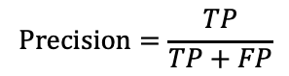
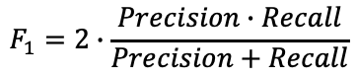
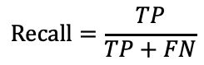
Business Should Drive Metrics
Obtain Data
Scrub
Explore
Model
Use
 |  | Prediction
 |  | Non-Toxic | Toxic
 | Non-Toxic 90% | True Negative | False Positive (Unnecessary Cost, Rejected Candidate)
 | Toxic 10% | False Negative (Clinical Failure) | True Positive
$$F_{1}=2∙\frac{Precision∙Recall}{Precision+Recall}$$
Truth
$$Recall=\frac{TP}{TP+FN}$$
$$Precision=\frac{TP}{TP+FP}$$

Slide 5

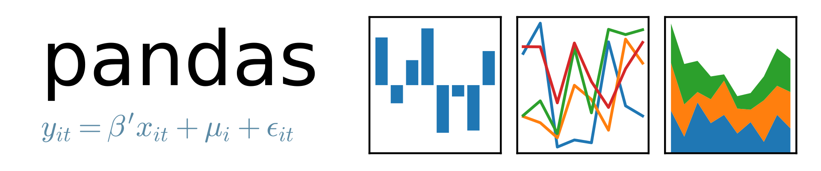








Modeling
Obtain Data
Scrub
Explore
Model
Use
Data Handling, Pre-Processing
Neural Network Design & Training
Metrics, Visualization
Hyperparameter Tuning
(Bayesian Optimization)
imblearn

Slide 6
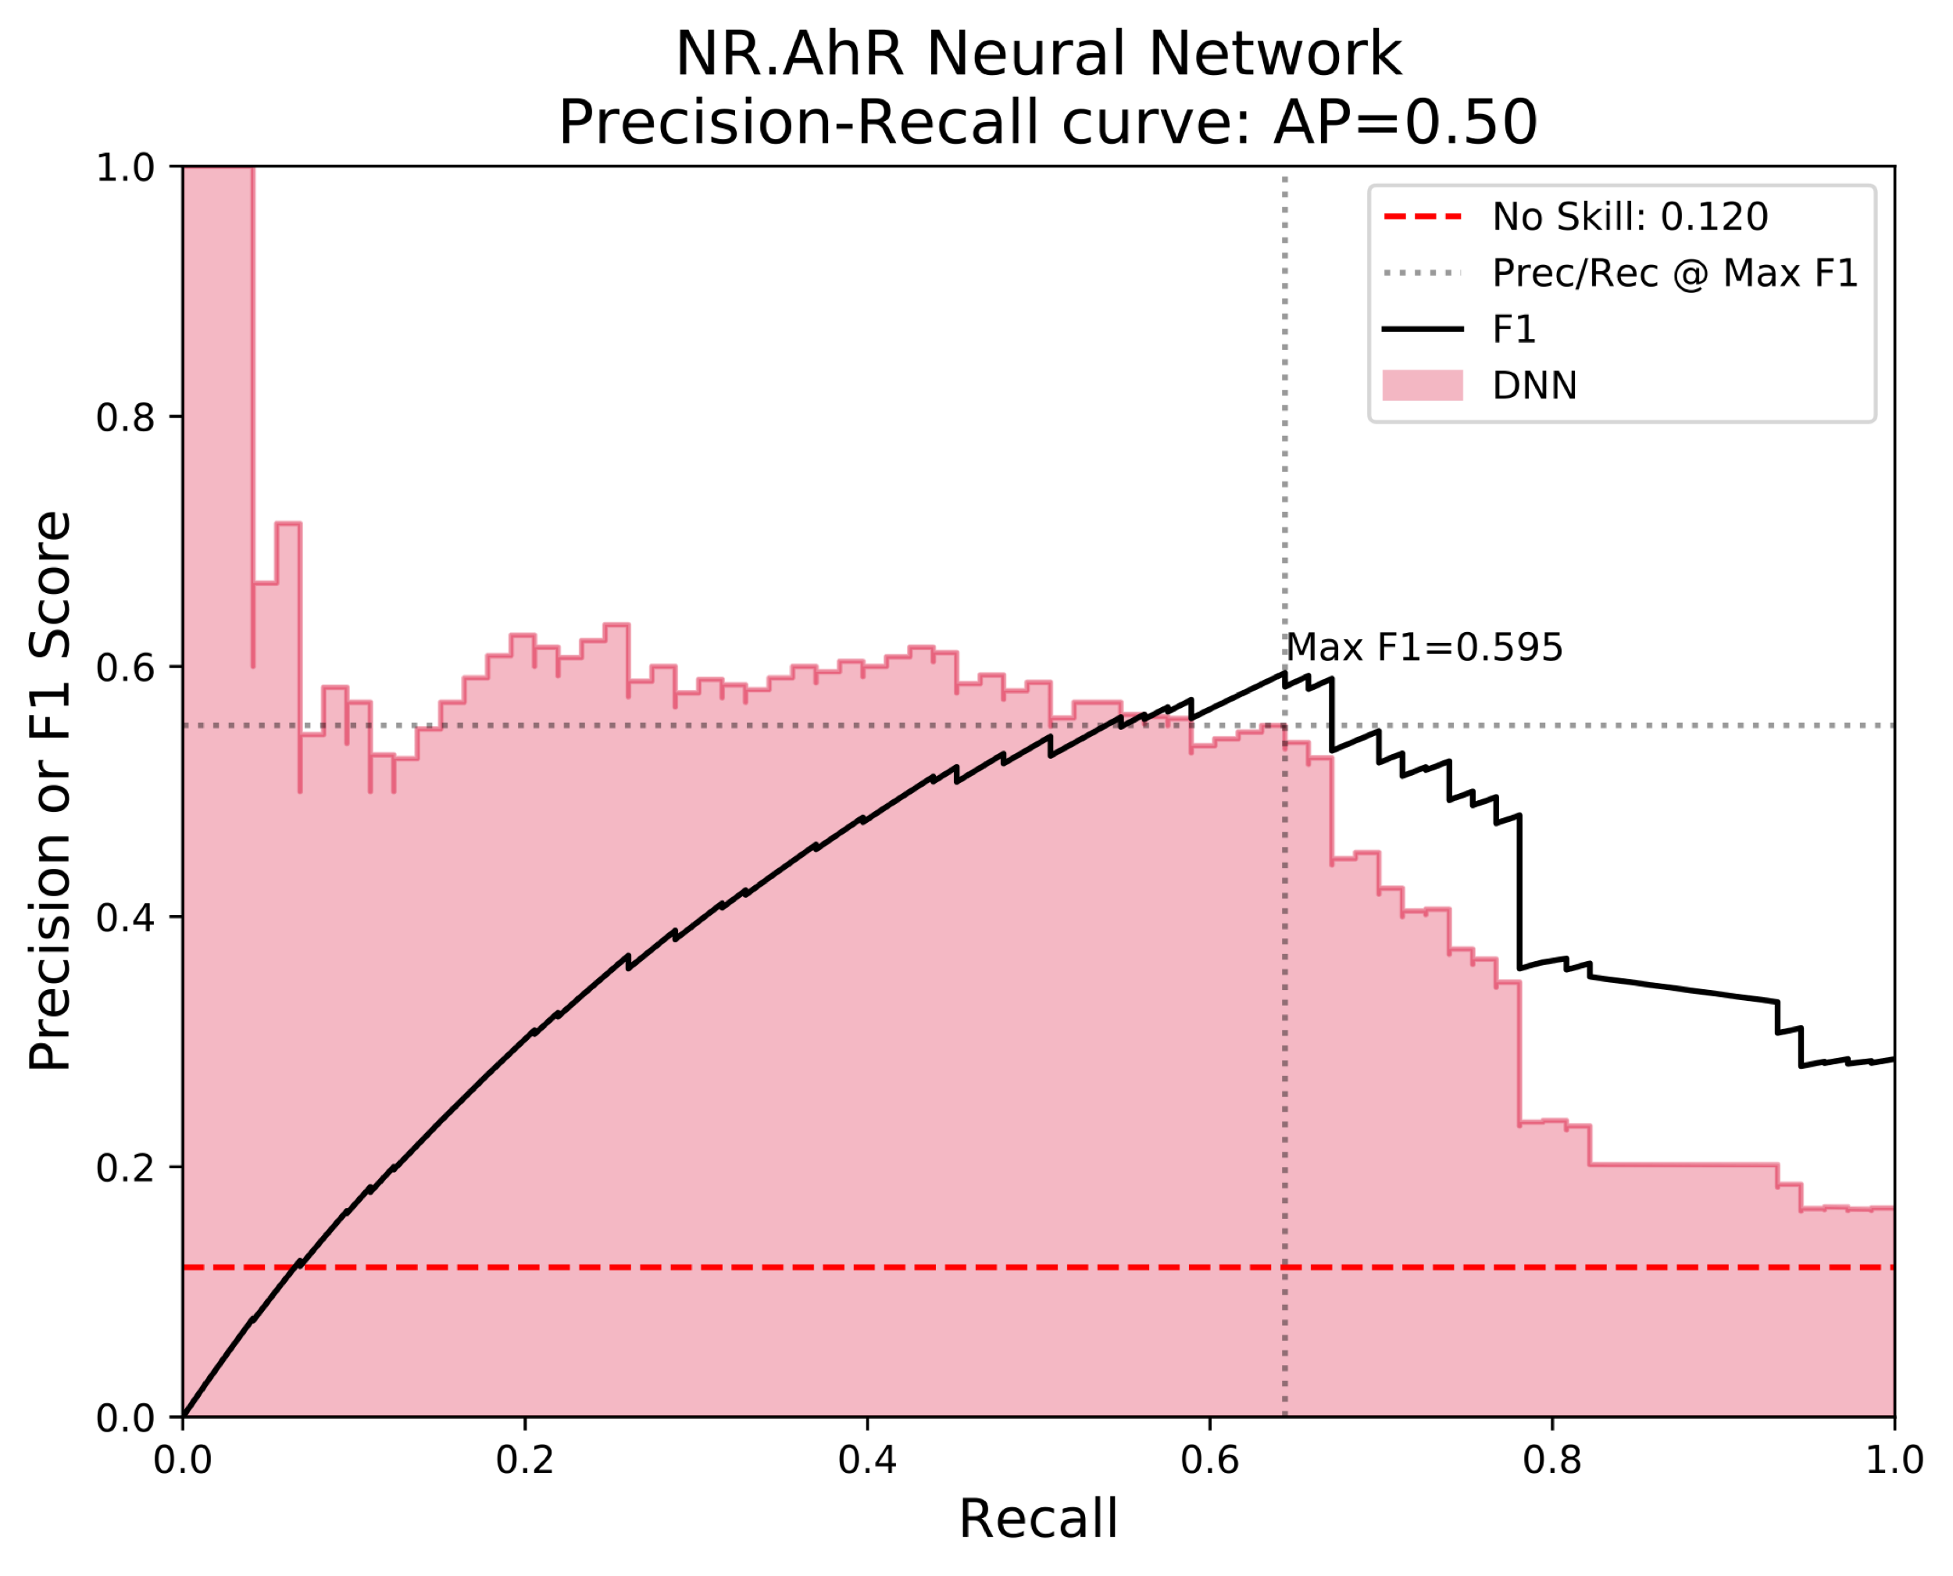

Using Results
Obtain Data
Scrub
Explore
Model
Use
$${F_{1}}_{\text{Random} \text{Forest}}=0.51$$

Slide 7
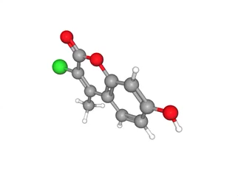
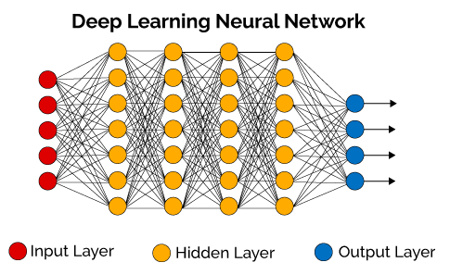


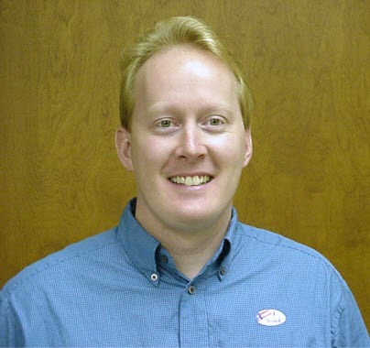
THANKS
Dense Neural Networks
Please contact me with any questions?
Sean Davern
sean@lizandsean.com
(206) 919-2026
@seandavern

Slide 8
Appendix

Slide 9

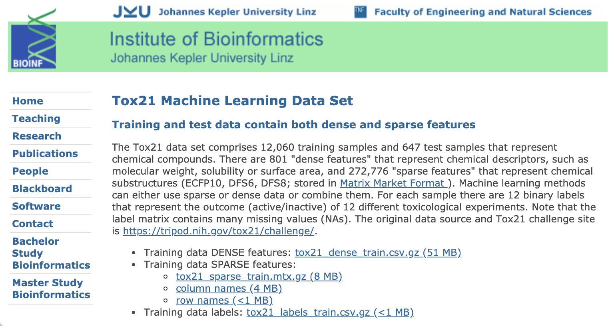
Government Program to Data Set
Notes:
In 2005 the EPA initiated a long-range vision for toxicity testing. In 2014 the NIH held its Tox21 Data Challenge providing a data set of 12,060 compounds and the results of 12 well defined analytical tests that indicate human toxicity in one or several metabolic pathways. In 2016 Johannes Keppler University in Linz, Austria made the data set available for machine learning projects.

Slide 10
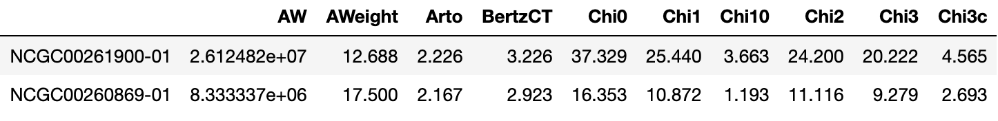
Data
For 12,060 training + 647 test compounds:
Inputs (X)
801 physio chemical compound features
2 stereo spatial fingerprint encodings → 272,000 features
Targets (Y)
12 binary indicators of toxicity against a specific test method

Slide 11
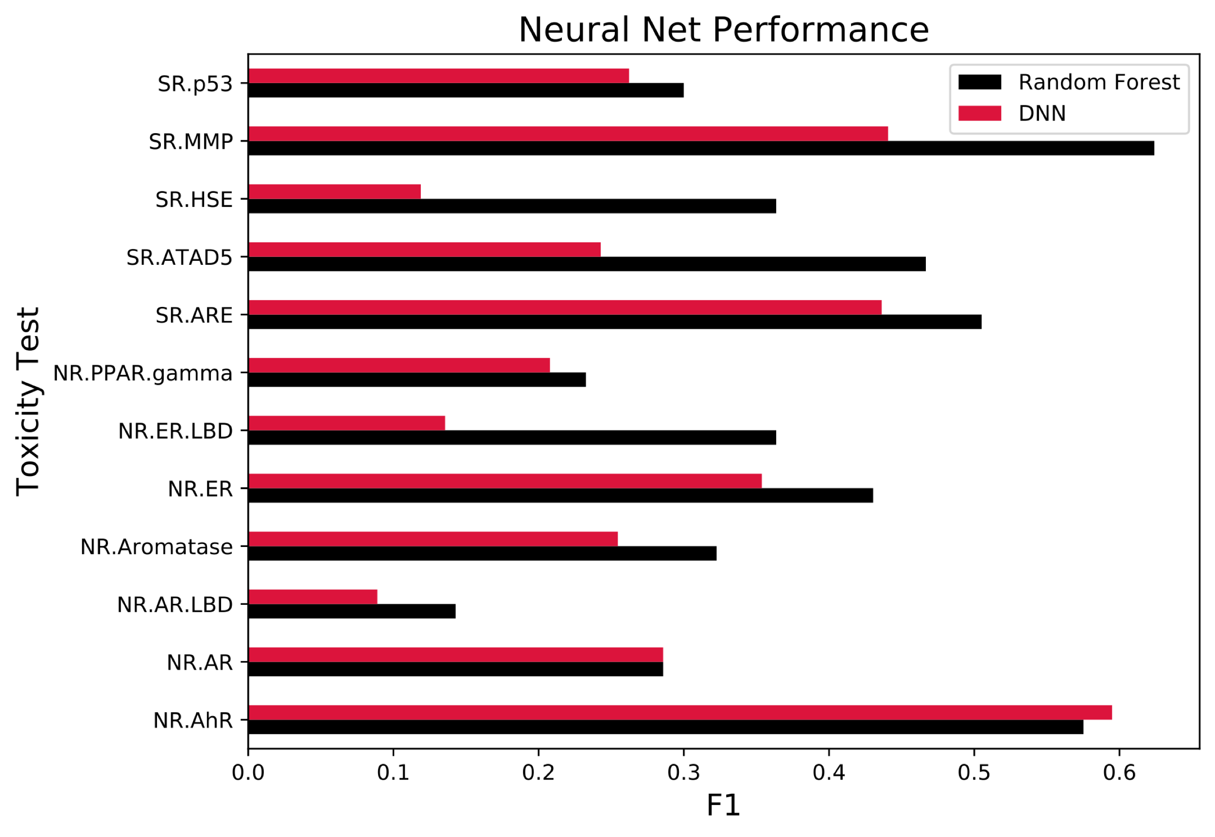
Using Results
Obtain Data
Scrub
Explore
Model
Use

Slide 12
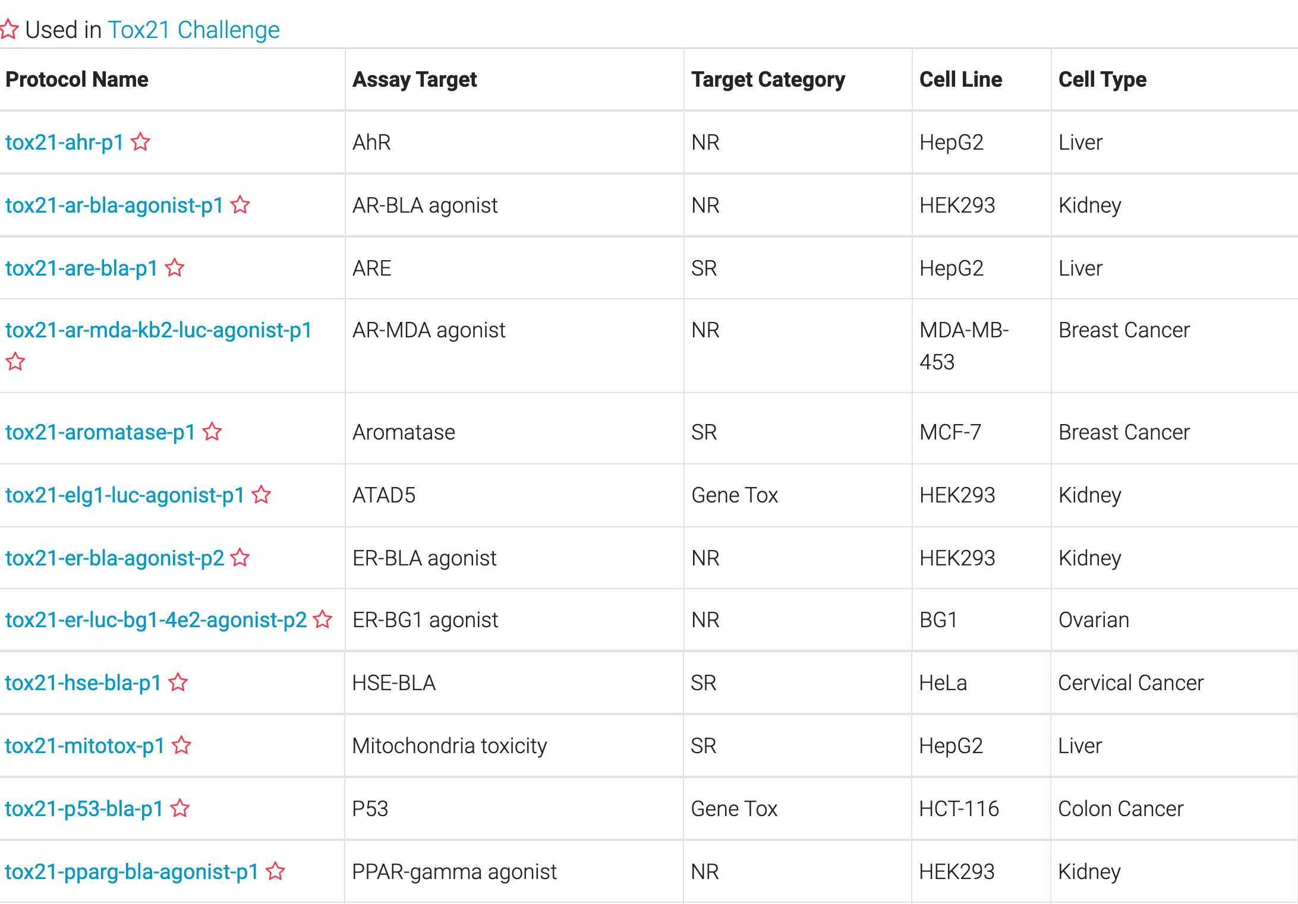
Toxicity Tests
Notes:
https://tripod.nih.gov/tox21/assays/

